Slide 1



Prediction of Accident Severity
Sai Dinesh Kumar Reddy Addula

Slide 2


Introduction
Road accidents are rising globally, leading to millions of deaths annually.
Key contributors to severe injuries include - Poor road conditions
Various vehicle types
Human behavior (e.g., distracted driving, speeding)
Speed limits
These factors interact in complex, non-linear ways. This complexity makes it difficult to create effective road safety models.

Slide 3
Dataset Overview
• Source: Kaggle – US Road Accidents (2021-2022)
• Total Records: 307,973
• Key Features:
- Accident Severity, Weather Conditions, Road Type, Speed Limit, Light Conditions, Vehicle Type
• Challenges:
- Class imbalance (severe vs. minor accidents)
- Missing values in key attributes
- High dimensionality requiring feature selection

Slide 4

EXISTING METHODOLOHIES
Method 1 : Road Accident Severity Prediction — A Comparative Analysis of Machine Learning Algorithms
Method 2 : The random forest algorithm for statistical learning
Method 3 : Neural Network

Slide 5
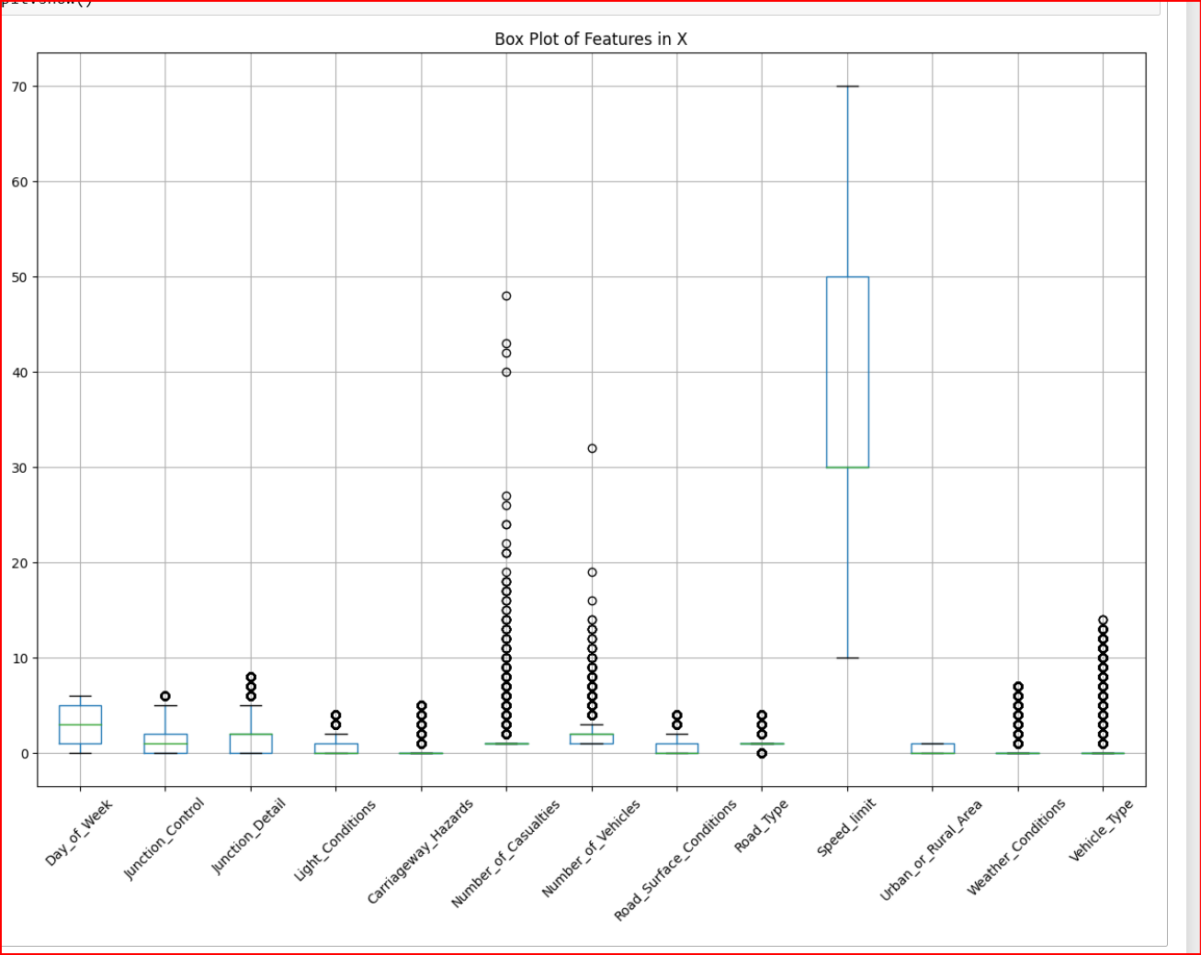
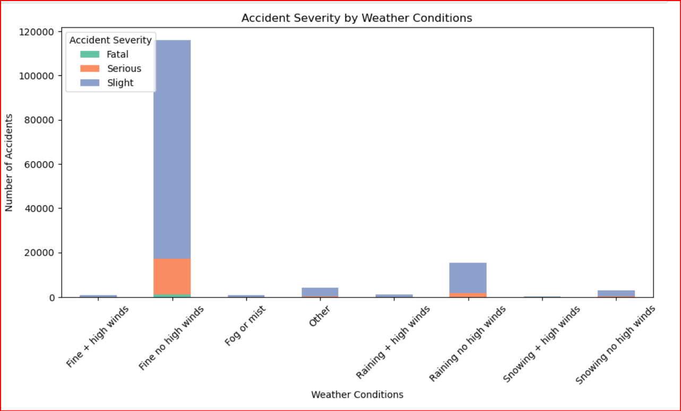
Exploratory Data analysis
As we oberve, there are a lot of outliers, and we plotted this using boxplots ( via IQR)
The Accident severity looks slight and little bit serious on days with fine with no winds

Slide 6
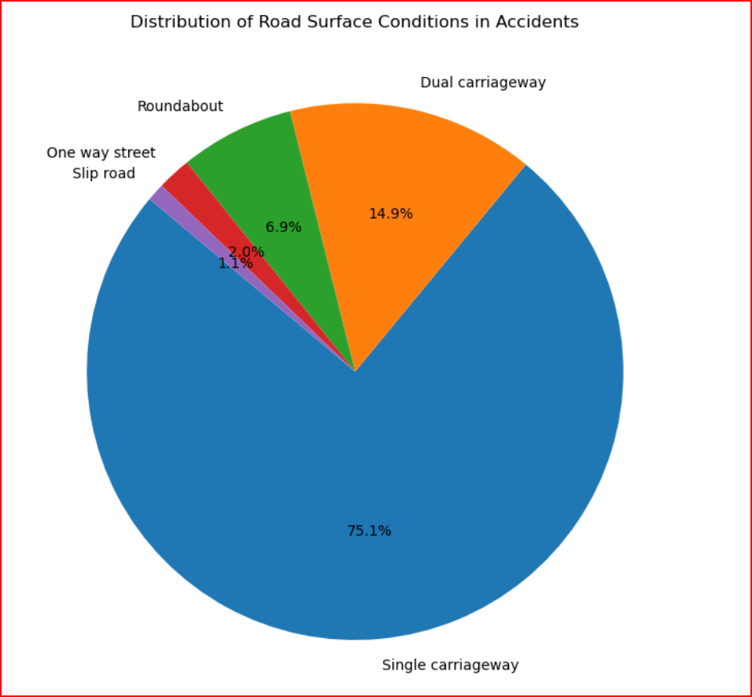
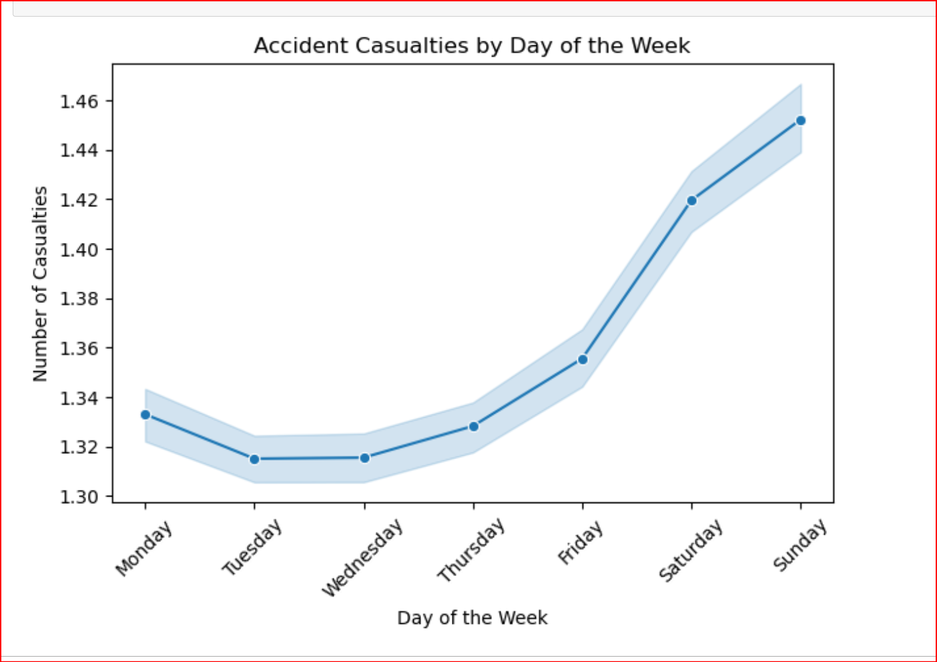
Exploratory Data analysis
We see a rise in Accident casualties by the time of the weekend
Single carriageway seems to be the major reason to contribute to accidents

Slide 7
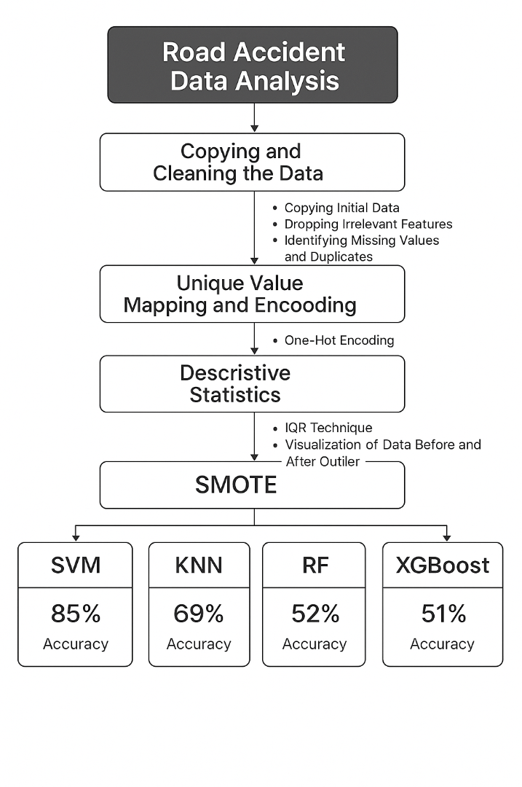
proposed Methodology
Cleaned and preprocessed road accident data by handling missing values and removing duplicates.
Applied One-Hot Encoding, and IQR for transformation and outlier treatment.
Conducted Exploratory Data Analysis using visual tools and correlation analysis.
Trained models (SVM, KNN, RF, XGBoost) with techniques like SMOTE and normalization.
Achieved best accuracy of 85% with SVM using SMOTE.

Slide 8
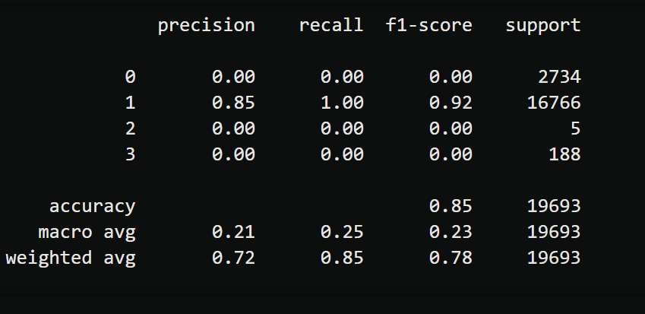
SVM rESULTS
Kernel = ‘linear, C= 100, gmma= 0.1

Slide 9
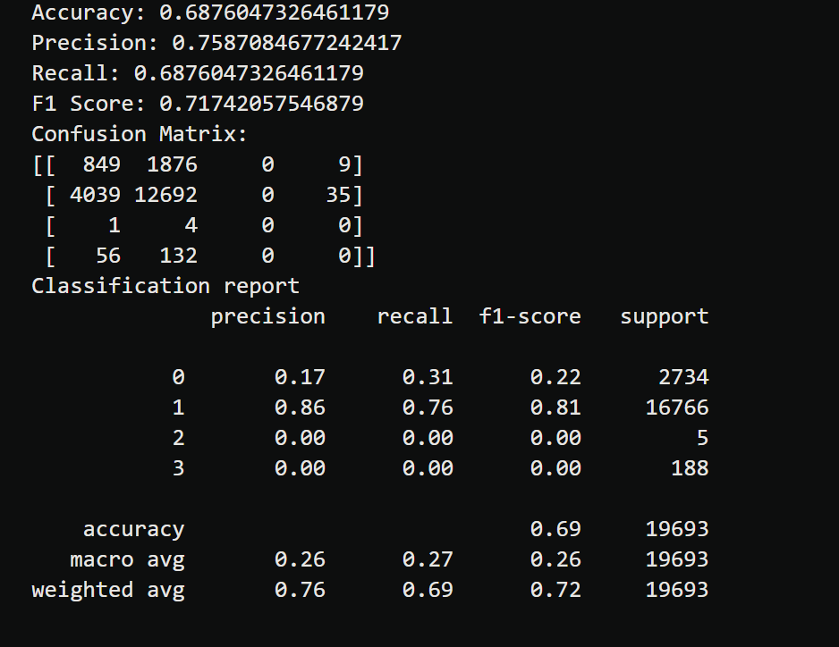
Knn Results
Weights = distance, algorithm = ‘ball_tree’, metric = ‘euclidean’

Slide 10
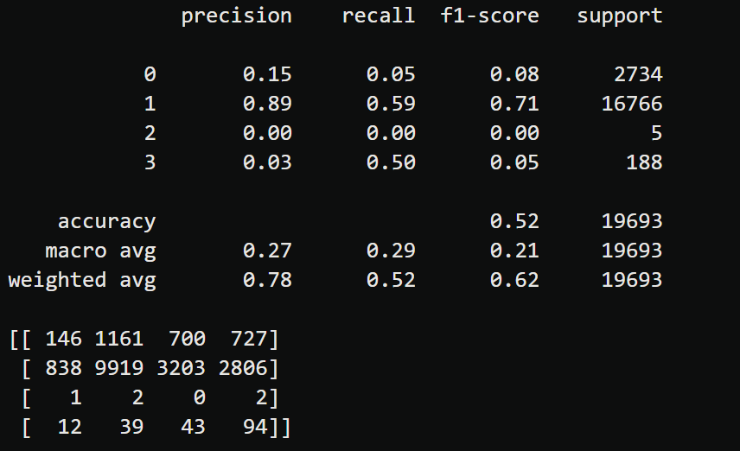
RF Results

Slide 11
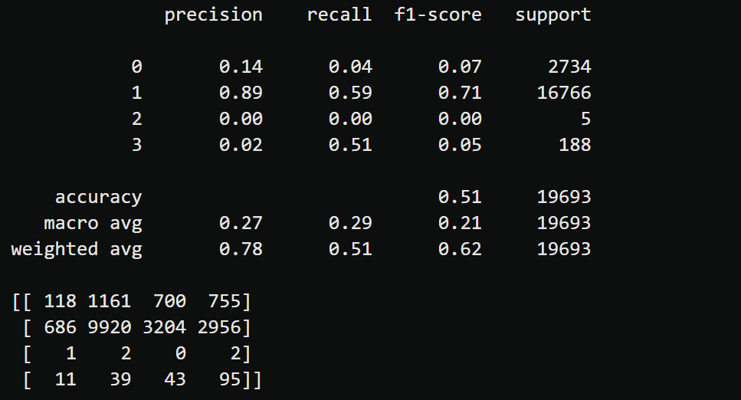
XGBoosT Resuts

Slide 12

Results
Outliers were successfully detected and removed using the IQR method (Box Plot), improving data quality.
Key accident factors identified include weather conditions, road type, and lighting.
SMOTE effectively balanced the dataset, addressing class imbalance issues.
Various machine learning models were trained and tested on the refined dataset.
Support Vector Machine (SVM) delivered the best performance with an accuracy of 85%.

Slide 13
REFRENCES
https://www.sciencedirect.com/science/article/pii/S2590198223000611
https://ieeexplore.ieee.org/document/9693055
https://towardsdatascience.com/what-is-eda-yes-another-post-on-eda-d8b5c06269a9
https://rpubs.com/Magguire/913785
https://www.kaggle.com/code/faressayah/support-vector-machine-pca-tutorial-for-beginner
http://prody.csb.pitt.edu/manual/reference/dynamics/pca.html
https://www.kaggle.com/code/shubhisaxena12/eda-and-pca-analysis
https://journals.sagepub.com/doi/10.1177/1536867X20909688

Slide 14
Conclusion
• Our project aims to leverage machine learning for accident severity prediction.
• Addressing challenges in data imbalance, feature selection, and model optimization.
• Results can contribute to enhanced road safety policies and accident prevention.
• Future work includes incorporating real-time accident data sources.

Slide 15
Questions?
Thank you for your attention!
We welcome your questions and feedback.

